Slide 1
Digital Signal Processing
Dr. Michael Nasief
Lec 7

Slide 2
Chapter [6]
DFT

Slide 3
THE DISCRETE-TIME FOURIER TRANSFORM
The discrete-time Fourier transform (DTFT) of a sequence, x(n), is defined as
s
Remember

Slide 4
The DFT
DTFT: continuous variable “w”
DFS: discrete Fourier Series for Periodic sequence
DFT: for non periodic finite sequence

Slide 5
DFS : Discrete Fourier Series

Slide 6
Example

Slide 7
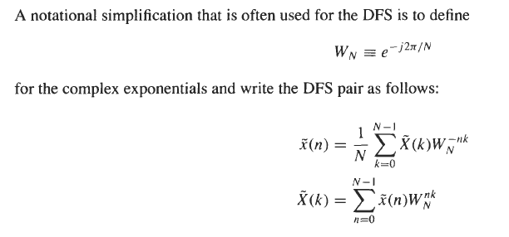
WN Notation

Slide 8
DFS Properties
Linearity
Shift

Slide 9
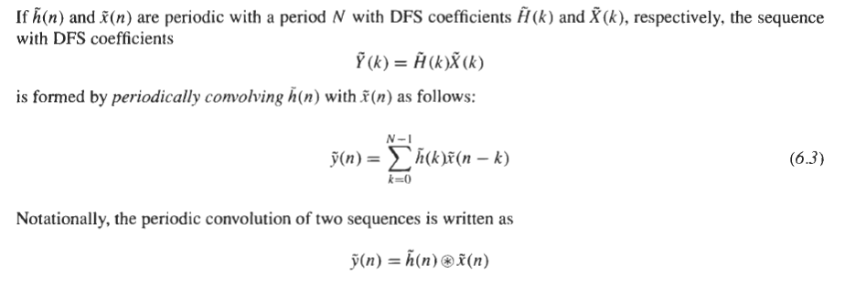
Periodic Convolution

Slide 10
Example

Slide 12
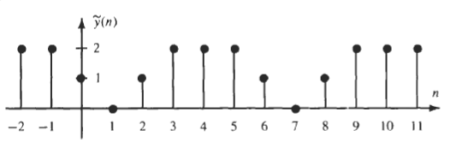
Solution

Slide 13
Discrete Fourier Transform DFT

Slide 14
DFT PROPERTIES

Slide 15
Circular Shift

Slide 16
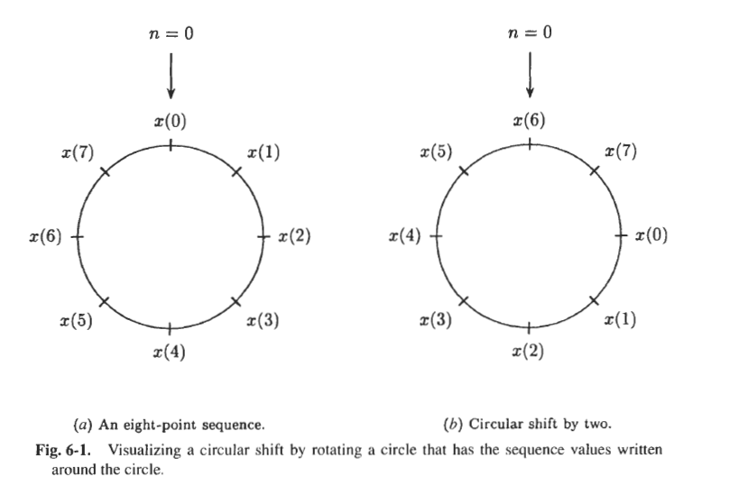
Circular Shift

Slide 17
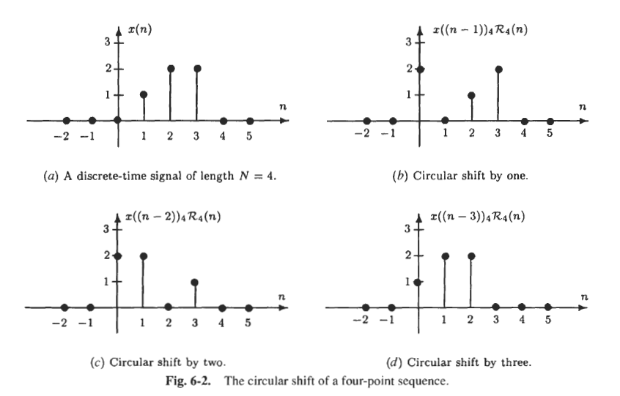
Circular Shift

Slide 18
Circular Shift

Slide 19
Circular Convolution

Slide 20
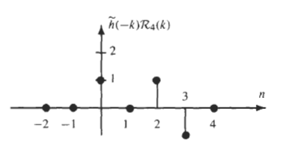
Example

Slide 21
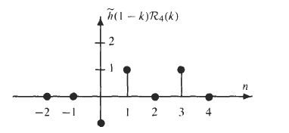

Slide 22
Note

